Slide 1
HOUSING: PRICE PREDICTION
Submitted by: Ankit Soran

Slide 2

Predicting House Prices with Linear Regression | Machine Learning
I know that you’ve always dreamed of dominating the housing market. Until now, that was impossible. But with this limited offer you can… got a bit sidetracked there.
Let’s start building our model with Python, but this time we will use it on a more realistic dataset.

Slide 3
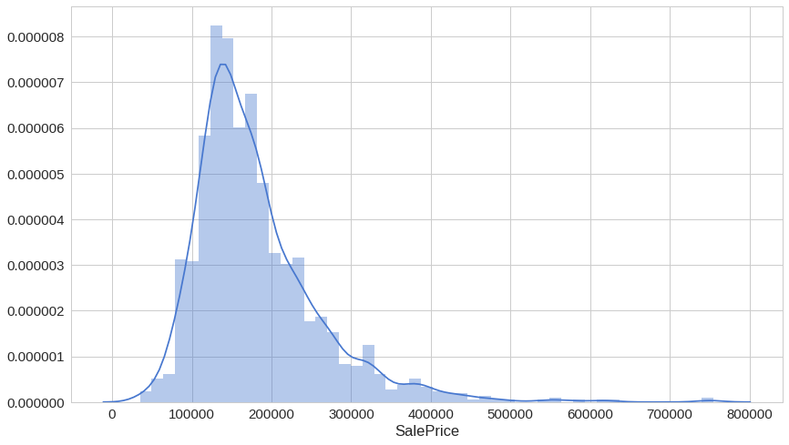
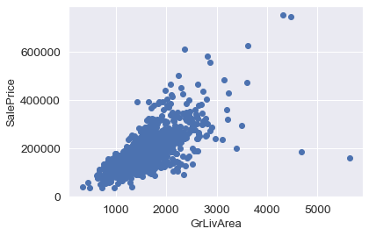
The Data
Our data comes from a client named “House Prices: Prediction”. It contains 1460 training data points and 80 features that might help us predict the selling price of a house.
Most of the density lies between 100k and 250k, but there appears to be a lot of outliers on the pricier side.
Next, let’s have a look at the greater living area (square feet) against the sale price:
You might’ve expected that larger living area should mean a higher price. This chart shows you’re generally correct. But what are those 2–3 “cheap” houses offering huge living area?

Slide 4
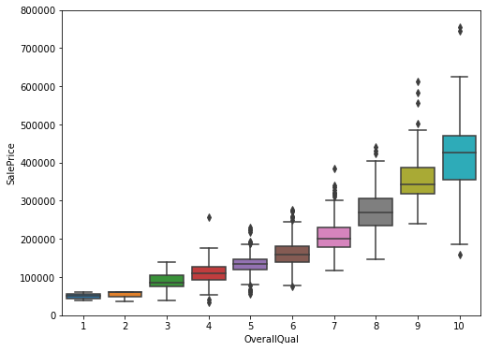
The Data
One column you might not think about exploring is the “TotalBsmtSF” — Total square feet of the basement area, but let’s do it anyway:
Intriguing, isn’t it? The basement area seems like it might have a lot of predictive power for our model.
Ok, last one. Let’s look at “OverallQual” — overall material and finish quality. Of course, this one seems like a much more subjective feature, so it might provide a bit different perspective on the sale price.

Slide 5
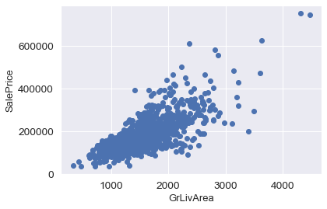
DATA CLEANING:
The main aim of Data Cleaning is to identify and remove errors &duplicate data, in order to create a reliable dataset. . The process of data cleaning is done by using a very famous library pandas.. Initially, those columns/features are dropped from our dataset who are not important in deciding the final price.•
The rows having a null value in any columns are dropped from our dataset.. The columns having characters as well as integer values are converted into integer values only.
Many more data cleaning techniques are used to improve the quality of our dataset.

Slide 6
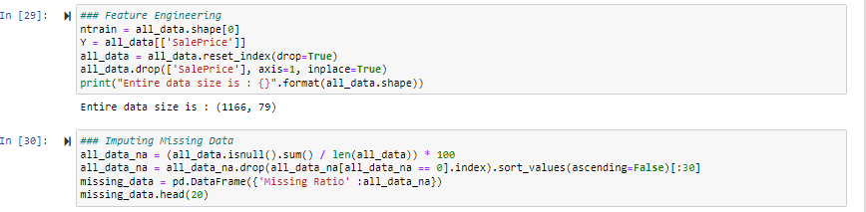
FEATURE ENGINEERING:
Feature engineering is the process of using domain knowledge to extract features from raw data via data mining techniques. These features can be used to improve the performance of machine learning algorithms. Feature engineering can be considered as applied machine learning itself.• Dimensionality reduction techniques are used in our dataset to reduce those rows who are not very much important to decide the house price.

Slide 7
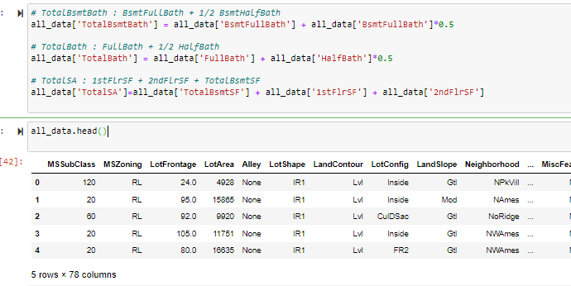
ONE HOT ENCODING
This technique is used to convert the categorical variables into numeric values.. Our dataset contains a categorical variable which is "location".. We have used one hot encoding method to convert them as numeric values.

Slide 8
MODEL CREATION & RESULT/OUTPUT
• The process of modeling means training a machine learning algorithm to predict the labels from the features.. We have used Linear Regression algorithm for training and testing of the model.•
The accuracy rate of our model is 91% which is pretty good.
• We created a function to predict the house price.
• Our function be like " predict price(location, sqft, bath,bhk)“
• When we pass the values into our function, it will predict house price for us.

Slide 9
Thank You

